Slide 1


ADC Potentiometer Bar Graph
ELECTRICAL ENGINEERING AND COMPUTER SCIENCE, COLLEGE OF ENGINEERING AND PHYSICAL SCIENCES
Notes:
Updated 13 Jun 2024 by Noah Mulvaney

Slide 2
Goals
Discuss the Analog to Digital Conversion feature of Arduino.
Introduce the potentiometer and showcase an application of it.
If time allows discuss:
User Defined Functions
Switch Cases

Slide 3
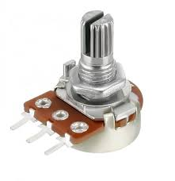
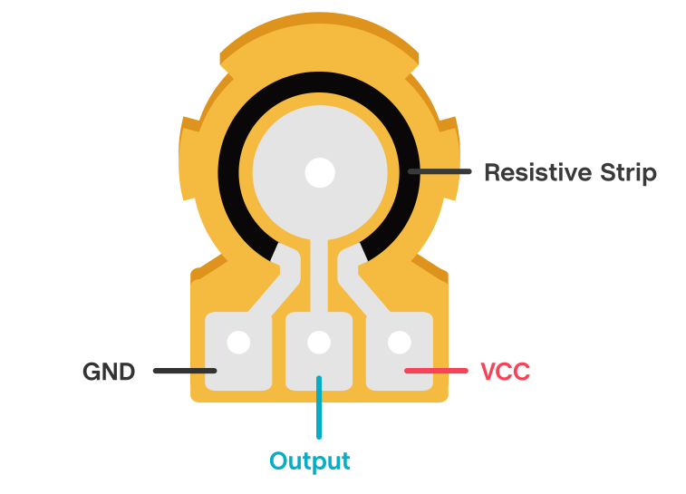
What is a Potentiometer
Essentially a variable resistor
Uses a resistive strip and a wiper to physically alter its resistance
Our potentiometers will output a voltage of 5 volts to 0 volts
Notes:
https://commons.wikimedia.org/wiki/File:Sonar_Principle_EN.svg

Slide 4
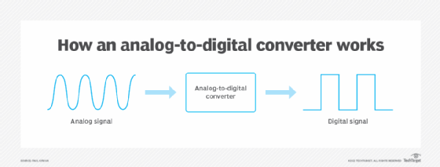
Analog to Digital Conversion With Arduino
Computers can normally only handle digital information (HIGH or LOW/ 1 or 0)
If a value that falls between HIGH or LOW needs to be used, it must be converted using Analog to Digital Conversion.
The analog input pins (A0-A5) on the Arduino make this process relatively easy.
With a resolution of 10 bits, converts the read voltage to a value between 0 and 1023
Notes:
https://commons.wikimedia.org/wiki/File:Sonar_Principle_EN.svg

Slide 5
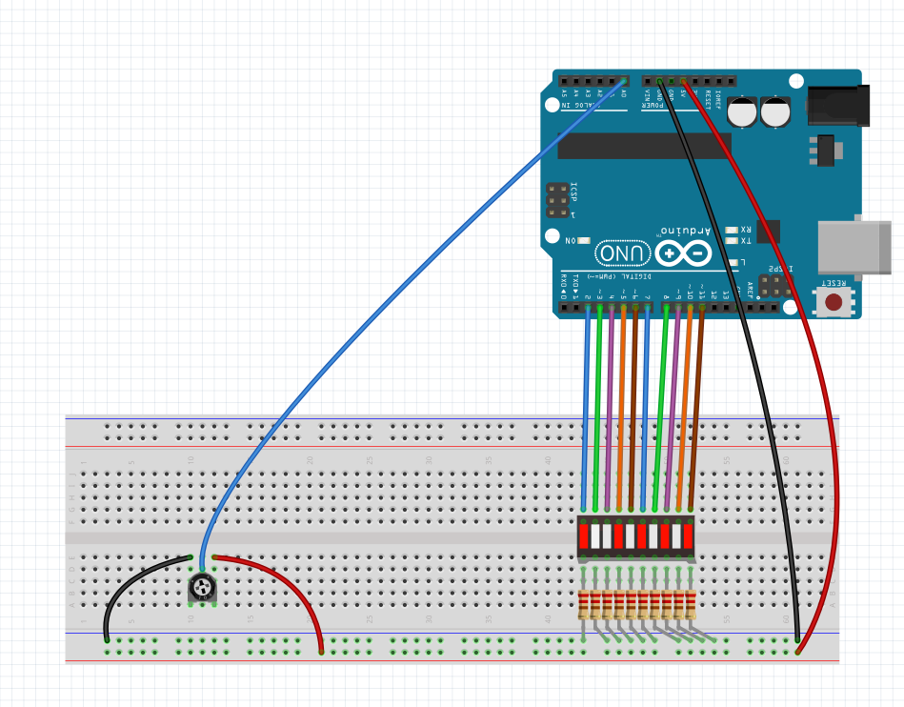
The Circuit
A0
5V
Labeled Side
2
11
GND
All 220 ohm
Notes:
https://commons.wikimedia.org/wiki/File:Sonar_Principle_EN.svg

Slide 6
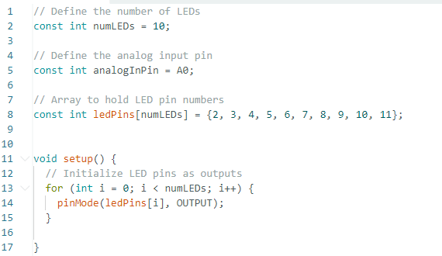

The Code
Open the ADC_Pot_Bar_Graph_Temp.ino File in the Arduino IDE
Notes:
https://commons.wikimedia.org/wiki/File:Sonar_Principle_EN.svg

Slide 7
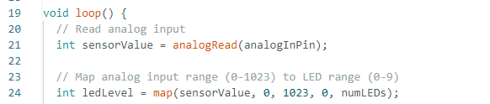
The Code
Notes:
https://commons.wikimedia.org/wiki/File:Sonar_Principle_EN.svg

Slide 8
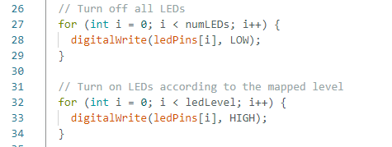

The Code
Notes:
https://commons.wikimedia.org/wiki/File:Sonar_Principle_EN.svg

Slide 9
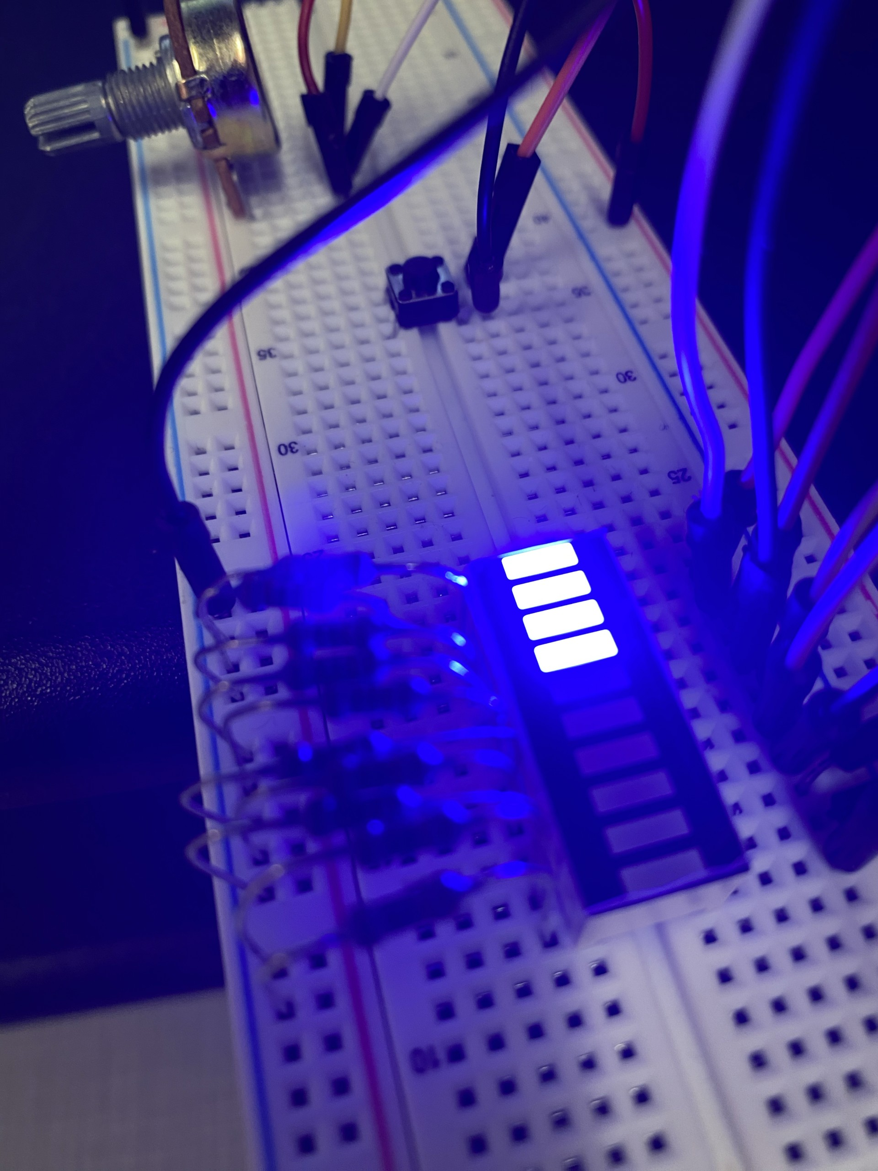
Run the Code
Turn the Potentiometer and watch the LEDs light up accordingly.
If no LEDS turn on, flip your bar graph around.
Notes:
https://commons.wikimedia.org/wiki/File:Sonar_Principle_EN.svg

Slide 10
Advanced Introduction
We will now use a pushbutton to control different “modes” of the bar graph.
To do this we will use two more advanced techniques:
User Defined Functions
Switch Case Block
Notes:
https://commons.wikimedia.org/wiki/File:Sonar_Principle_EN.svg

Slide 11
User Defined Functions
Blocks of code made by the user to perform certain tasks
Great for repetitive tasks, cleaner code, and performing similar actions with different variables.
The “definition” of the functions is written outside of the void loop and contains the actual code to run.
The “header” of the function is placed in the code where the function needs to run similar to other pre-defined functions
Notes:
https://commons.wikimedia.org/wiki/File:Sonar_Principle_EN.svg

Slide 12
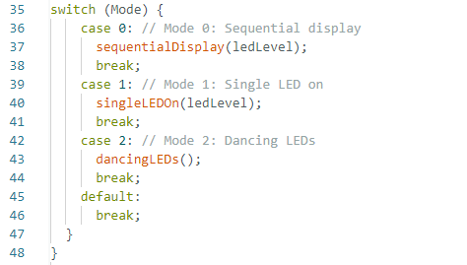
Switch Case
A way to change what happens in the code based on the state of a variable.
Our code runs through three different display options based on the state of the “Mode” variable.
Notes:
https://commons.wikimedia.org/wiki/File:Sonar_Principle_EN.svg

Slide 13
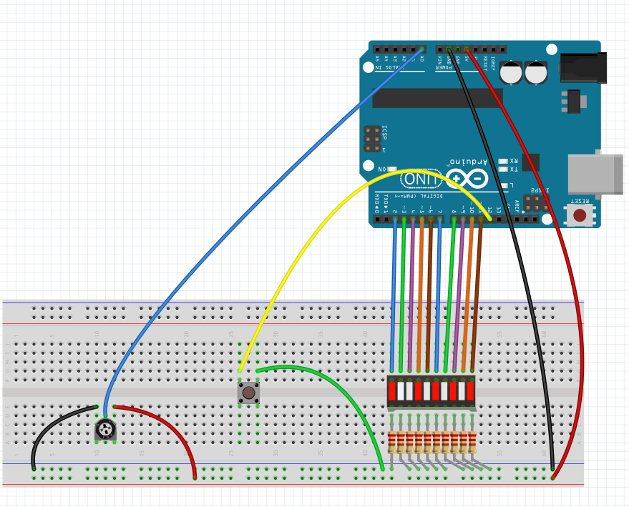
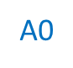

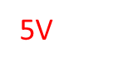
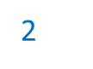
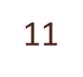
Advanced Circuit
Same circuit as before but with an added push button connected to pin 12
12
All 220 ohm
Notes:
https://commons.wikimedia.org/wiki/File:Sonar_Principle_EN.svg

Slide 14
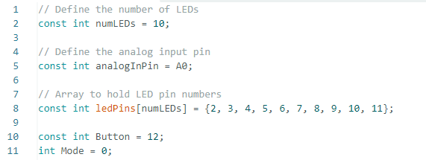

Advanced Coding
Open the ADC_Pot_Bar_Graph_Advanced_Temp.ino File in the Arduino IDE
Notes:
https://commons.wikimedia.org/wiki/File:Sonar_Principle_EN.svg

Slide 15
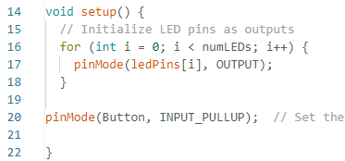

Advanced Coding
Notes:
https://commons.wikimedia.org/wiki/File:Sonar_Principle_EN.svg

Slide 16
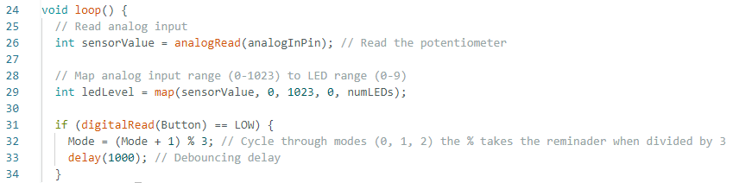
Advanced Coding
Notes:
https://commons.wikimedia.org/wiki/File:Sonar_Principle_EN.svg

Slide 17
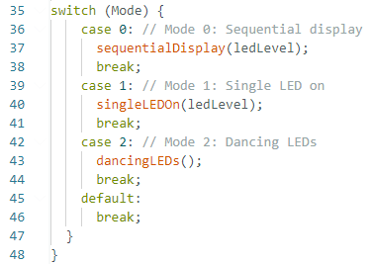

Advanced Coding
Notes:
https://commons.wikimedia.org/wiki/File:Sonar_Principle_EN.svg

Slide 18

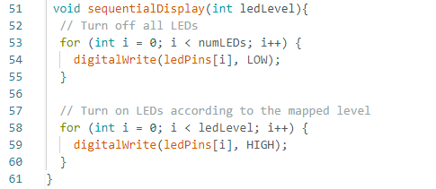
Advanced Coding
Notes:
https://commons.wikimedia.org/wiki/File:Sonar_Principle_EN.svg

Slide 19
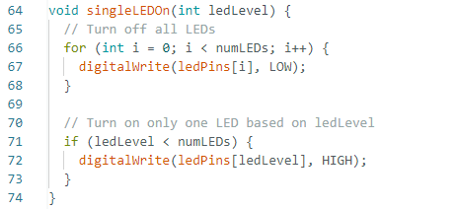

Advanced Coding
Notes:
https://commons.wikimedia.org/wiki/File:Sonar_Principle_EN.svg

Slide 20

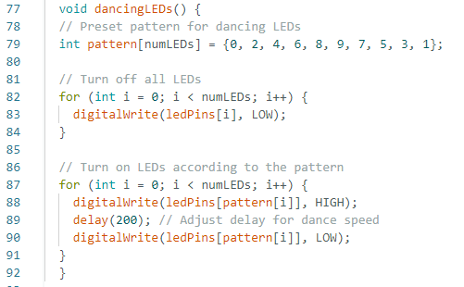
Advanced Coding
Notes:
https://commons.wikimedia.org/wiki/File:Sonar_Principle_EN.svg

Slide 21

Run the New Program
Now, when you press the button the program will switch between three different modes of operation: Sequential LED, Single LED, and Dancing.
Notes:
https://commons.wikimedia.org/wiki/File:Sonar_Principle_EN.svg

